Slide 1
IT304 Computer Networks Week 5-Lec 2
Transmission Control Protocol -Fundamentals

Slide 2
UDP: User Datagram Protocol
Why is there a UDP?
“no frills,” “bare bones” Internet transport protocol
“best effort” service, UDP segments may be:
lost
delivered out-of-order to app
no connection establishment (which can add RTT delay)
simple: no connection state at sender, receiver
small header size
no congestion control
UDP can blast away as fast as desired!
can function in the face of congestion
connectionless:
no handshaking between UDP sender, receiver
each UDP segment handled independently of others

Slide 3
UDP: User Datagram Protocol
UDP use:
streaming multimedia apps (loss tolerant, rate sensitive)
DNS
SNMP
HTTP/3
if reliable transfer needed over UDP (e.g., HTTP/3):
add needed reliability at application layer
add congestion control at application layer

Slide 4
UDP: Transport Layer Actions
SNMP client
SNMP server
application
application
transport
(UDP)
transport
(UDP)
network (IP)
network (IP)
link
link
physical
physical

Slide 5
UDP: Transport Layer Actions
SNMP client
SNMP server
UDP sender actions:
application
application
is passed an application-layer message
SNMP msg
transport
(UDP)
transport
(UDP)
determines UDP segment header fields values
UDP_{h}
SNMP msg
UDP_{h}
creates UDP segment
network (IP)
network (IP)
passes segment to IP
link
link
physical
physical

Slide 6
UDP: Transport Layer Actions
SNMP client
SNMP server
UDP receiver actions:
application
receives segment from IP
application
checks UDP checksum header value
transport
(UDP)
transport
(UDP)
SNMP msg
extracts application-layer message
network (IP)
network (IP)
SNMP msg
UDP_{h}
demultiplexes message up to application via socket
link
link
physical
physical

Slide 7
UDP segment header
32 bits
source port #
dest port #
length
checksum
application
data
(payload)
length, in bytes of UDP segment, including header
data to/from application layer
UDP segment format

Slide 8
Summary: UDP
“no frills” protocol:
segments may be lost, delivered out of order
best effort service: “send and hope for the best”
UDP has its plusses:
no setup/handshaking needed (no RTT incurred)
can function when network service is compromised
helps with reliability (checksum)
build additional functionality on top of UDP in application layer (e.g., HTTP/3)

Slide 9
Reliable Data Transfer: stop-and-wait operation
sender
receiver
L / R
=
L/R
U_{sender}
RTT
+ L / R
.008
RTT
=
30.008
=
0.00027
rdt 3.0 protocol performance stinks!
Protocol limits performance of underlying infrastructure (channel)

Slide 10
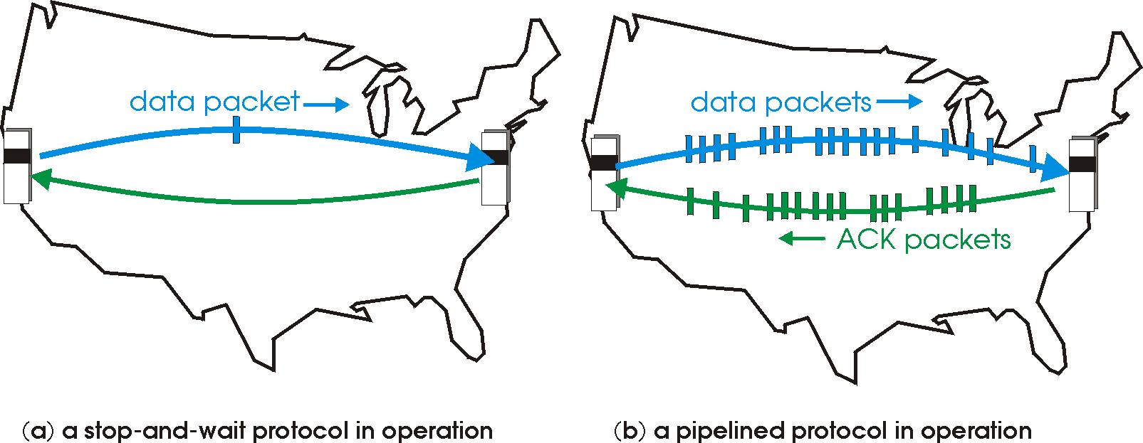

Reliable Data Transfer : pipelined protocols operation
pipelining: sender allows multiple, “in-flight”, yet-to-be-acknowledged packets
range of sequence numbers must be increased
buffering at sender and/or receiver

Slide 11
Pipelining: increased utilization
sender
receiver
first packet bit transmitted, t = 0
last bit transmitted, t = L / R
first packet bit arrives
RTT
last packet bit arrives, send ACK
last bit of 2nd packet arrives, send ACK
last bit of 3rd packet arrives, send ACK
ACK arrives, send next
packet, t = RTT + L / R
3-packet pipelining increases
utilization by a factor of 3!
Notes:
two generic forms of pipelined protocols: go-Back-N, selective repeat

Slide 12
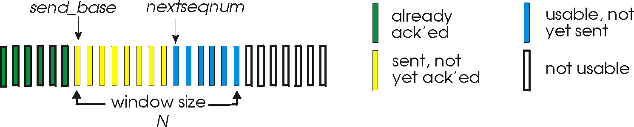
Go-Back-N: sender
sender: “window” of up to N, consecutive transmitted but unACKed pkts
k-bit seq # in pkt header
cumulative ACK: ACK(n): ACKs all packets up to, including seq # n
on receiving ACK(n): move window forward to begin at n+1
timer for oldest in-flight packet
timeout(n): retransmit packet n and all higher seq # packets in window
Notes:
window size of 14, 8 have been sent but are not yet acknowledged, 6 sequence numbers are available for us. In window, but no calls from above to use them.
Note – we’ll skip the Go-Back-N FSM specification you can check that out in PowerPoint slides or book)
TCP uses cumulative ACK

Slide 13
Go-Back-N: receiver
ACK-only: always send ACK for correctly-received packet so far, with highest in-order seq #
may generate duplicate ACKs
need only remember rcv_base
on receipt of out-of-order packet:
can discard (don’t buffer) or buffer: an implementation decision
re-ACK pkt with highest in-order seq #
Receiver view of sequence number space:
received and ACKed
…
…
Out-of-order: received but not ACKed
rcv_base
Not received
Notes:
Note – we’ll skip the Go-Back-N FSM specification (actually it’s

Slide 14

Go-Back-N in action
sender window (N=4)
sender
receiver
0 1 2 3 4 5 6 7 8
send pkt0
send pkt1
send pkt2
send pkt3
(wait)
0 1 2 3 4 5 6 7 8
receive pkt0, send ack0
receive pkt1, send ack1
receive pkt3, discard,
(re)send ack1
0 1 2 3 4 5 6 7 8
X
0 1 2 3 4 5 6 7 8
loss
0 1 2 3 4 5 6 7 8
rcv ack0, send pkt4
0 1 2 3 4 5 6 7 8
rcv ack1, send pkt5
receive pkt4, discard,
(re)send ack1
ignore duplicate ACK
receive pkt5, discard,
(re)send ack1
pkt 2 timeout
0 1 2 3 4 5 6 7 8
send pkt2
send pkt3
send pkt4
send pkt5
0 1 2 3 4 5 6 7 8
0 1 2 3 4 5 6 7 8
rcv pkt2, deliver, send ack2
rcv pkt3, deliver, send ack3
rcv pkt4, deliver, send ack4
rcv pkt5, deliver, send ack5
0 1 2 3 4 5 6 7 8
Notes:
Let’s skip FSM specification for GBN – check out the book or ppt – and let’s watch GBN sender and receivers in action.
Let assume a window size of 4. at t=0, sender sends packets 0, 1, 2 3, 4, and packet 2 will be lost
At the receiver:
Packet 0 received ACK0 generated
Packet 1 received ACK1 generated
Packet 2 is lost, and so when packet 3 is received, ACK 1 is sent – that’s the cumulative ACK, re-Acknowledging the receipt of packet 1. and in this implementation packet 3 is discarded

Slide 15
Selective repeat: the approach
pipelining: multiple packets in flight
receiver individually ACKs all correctly received packets
buffers packets, as needed, for in-order delivery to upper layer
sender:
maintains (conceptually) a timer for each unACKed pkt
timeout: retransmits single unACKed packet associated with timeout
maintains (conceptually) “window” over N consecutive seq #s
limits pipelined, “in flight” packets to be within this window
Notes:
An important mechanism of GBN was the use of the cumulative acknowledgements, and as we mentioned, cumulative ACKs are used in TCP
An alternate ACK mechanism would be for the receiver to individually acknowledge specific packets as they are received. This mechanism is at the heart of the Selective repeat protocol.

Slide 16
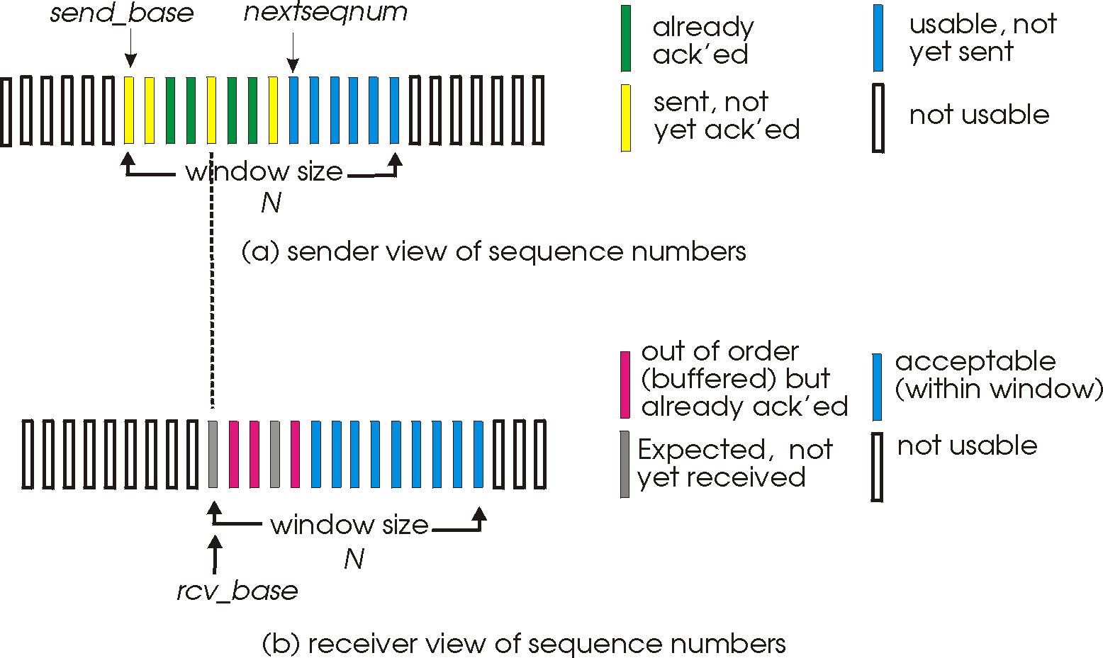
Selective repeat: sender, receiver windows

Slide 17
Selective repeat: sender and receiver
sender
receiver
data from above:
if next available seq # in window, send packet
timeout(n):
resend packet n, restart timer
ACK(n) in [sendbase,sendbase+N-1]:
mark packet n as received
if n smallest unACKed packet, advance window base to next unACKed seq #
packet n in [rcvbase, rcvbase+N-1]
send ACK(n)
out-of-order: buffer
in-order: deliver (also deliver buffered, in-order packets), advance window to next not-yet-received packet
packet n in [rcvbase-N,rcvbase-1]
ACK(n)
otherwise:
ignore
Notes:
If the packet is in order, its data will be delivered, as will any buffered data that can now be delivered in order

Slide 18
Selective Repeat in action
sender window (N=4)
sender
receiver
0 1 2 3 4 5 6 7 8
send pkt0
send pkt1
send pkt2
send pkt3
(wait)
0 1 2 3 4 5 6 7 8
receive pkt0, send ack0
receive pkt1, send ack1
receive pkt3, buffer,
send ack3
0 1 2 3 4 5 6 7 8
X
0 1 2 3 4 5 6 7 8
loss
0 1 2 3 4 5 6 7 8
rcv ack0, send pkt4
0 1 2 3 4 5 6 7 8
rcv ack1, send pkt5
receive pkt4, buffer,
send ack4
record ack3 arrived
receive pkt5, buffer,
send ack5
pkt 2 timeout
0 1 2 3 4 5 6 7 8
send pkt2
(but not 3,4,5)
0 1 2 3 4 5 6 7 8
0 1 2 3 4 5 6 7 8
rcv pkt2; deliver pkt2,
pkt3, pkt4, pkt5; send ack2
0 1 2 3 4 5 6 7 8
Q: what happens when ack2 arrives?

